Slide 1
Automated Hematological Analysis: A Machine
Learning Approach for Blood Cell Classification
Adam Finch, Pranay Reddy Gundala, and Tyler Rowe

Slide 2
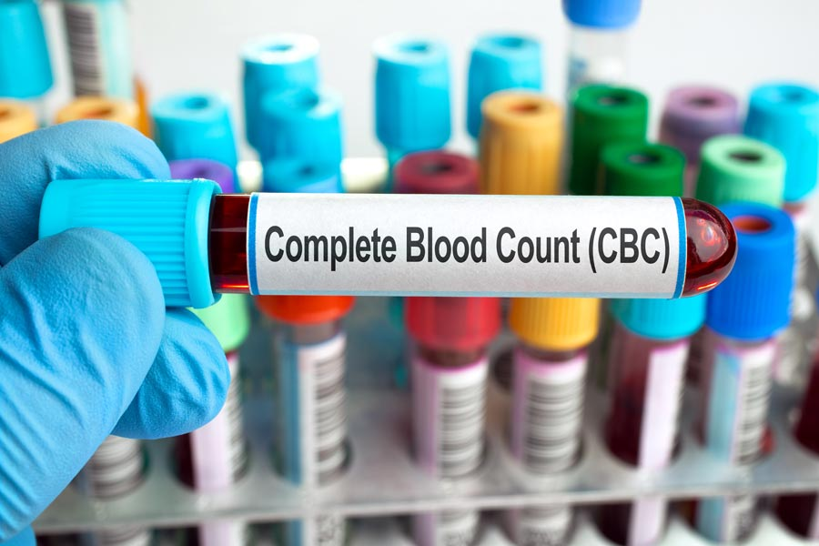
Area of Focus
Blood-based diseases impact hundreds of thousands of lives each year^{[1]}.
A complete blood count (CBC) is one common method used to evaluate general health and diagnose various hematological conditions.
Key components of a CBC test include counting White Blood Cells (WBC), Red Blood Cells (RBC), and Platelets
A blood differential test measures the amount of each subtype of WBC (Monoctyes, Lymphocytes, Neutrophils, and Eosinophils).
Notes:
Other facts: Within the United States alone, it is projected that
blood-based cancers will claim the lives of 57,380 people
in 2023.
WBC count in particular is crucial in identifying infections and hematological disorders
An abnormal WBC count can indicate the presence of an underlying health issue, prompting further investigation.

Slide 3
Traditional Methods^{[2]}
Manual CBC Test
Wintrobe-Hematocrit Method
Hematology Analyzers
The first procedure for performing a blood count is published by Karl Vierordt.
Machinery physically separates RBC from WBC to measure volume proportions
Today the most common method for CBC tests is Hematology Analyzer Machines
1852
1921
1929
1953
Present
Staining Techniques
Coulter Principle
Techniques for staining WBC and RBC were developed to make manual counting easier
Uses electrical impedance measurements to count blood cells and determine their sizes.
Notes:
WH Method is considered the first automated method for performing CBC tests.
After Coulter patented the Coulter Principle, blood counting machines were known as “Coulter Counters”
Source: https://meridian.allenpress.com/bit/article/43/4/300/141092/Hematology-Analyzers

Slide 4
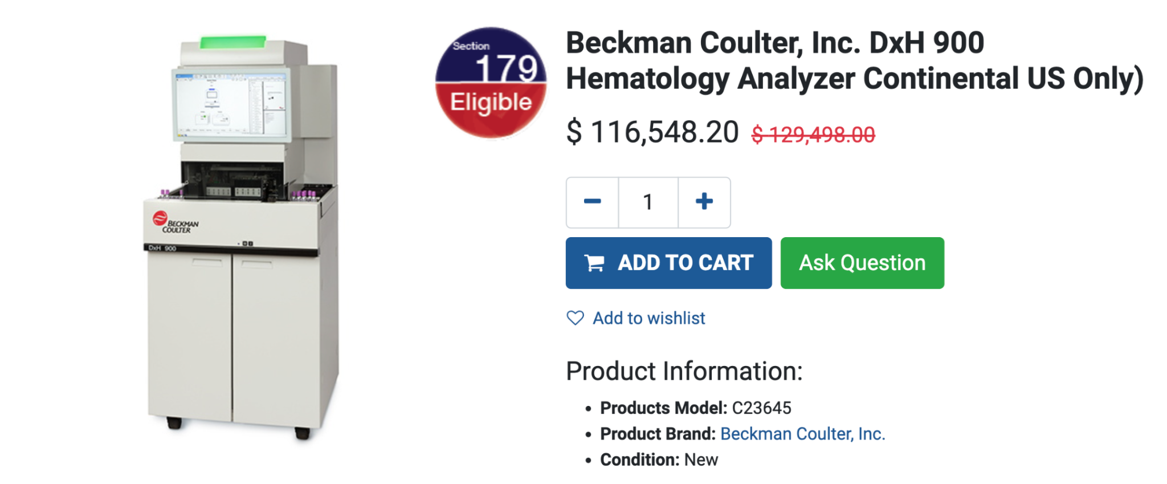
Traditional Methods
Problem:
A medical grade hematology analyzer is expensive
Time consuming process if blood samples need to be sent into a lab for counting

Slide 5
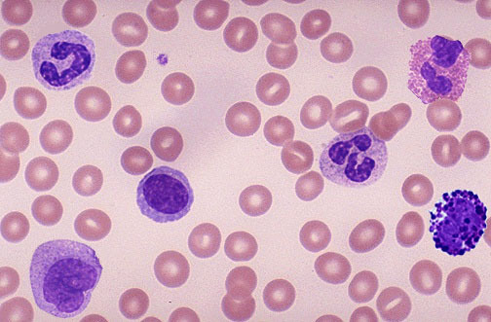
Proposal
Machine Learning Approach to CBC testing
Objective 1: Train a Convolutional Neural Network (CNN) to identify and classify between White Blood Cells, Red Blood Cells, and Platelets.
Objective 2: Classify between subtypes of White Blood Cells
4 main subtypes: Monoctyes, Lymphocytes, Neutrophils, and Eosinophils

Slide 6
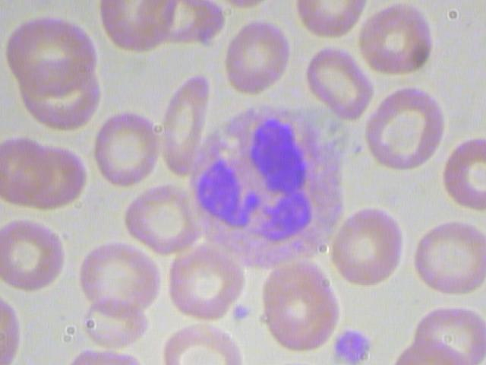
Objective 1: Data
We utilized the publicly available dataset “Blood Cell Images”, licensed by MIT, to train our model^{[3]}
The first dataset contains 410 jpg images of blood samples

Slide 7
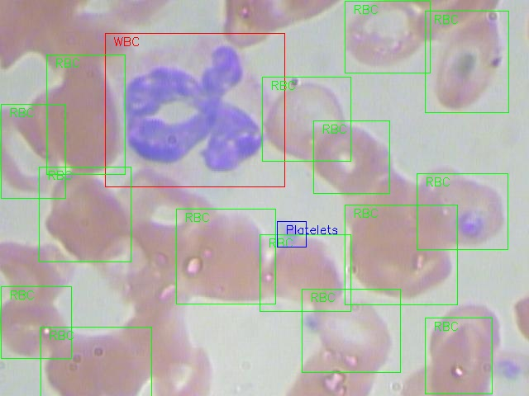
Objective 1: Data
The images are labeled with bounding box coordinates denoting where each WBC, RBC, and Platelet Cell are located.

Slide 8
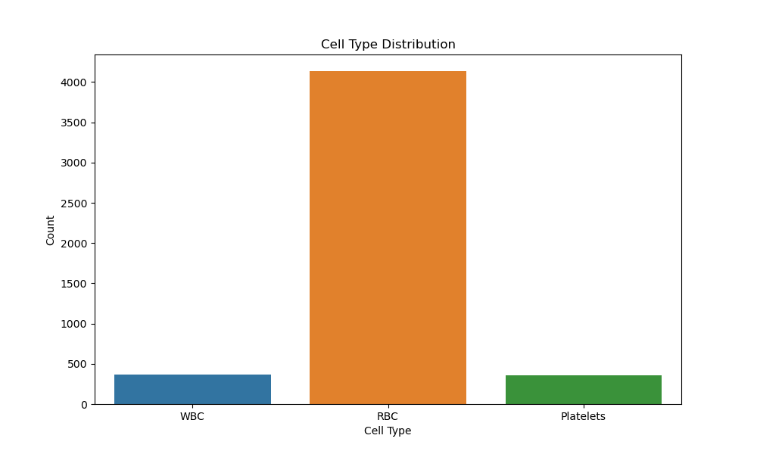
Objective 1: Data
The dataset predictably contains far more RBC than WBC or Platelets
In human blood samples, the typical ratio of RBC to WBC is about 600 to 1
Notes:
Because the dataset is focused on WBC, they are over represented compared to the normal ratio of RBC to WBC in normal blood samples.

Slide 9

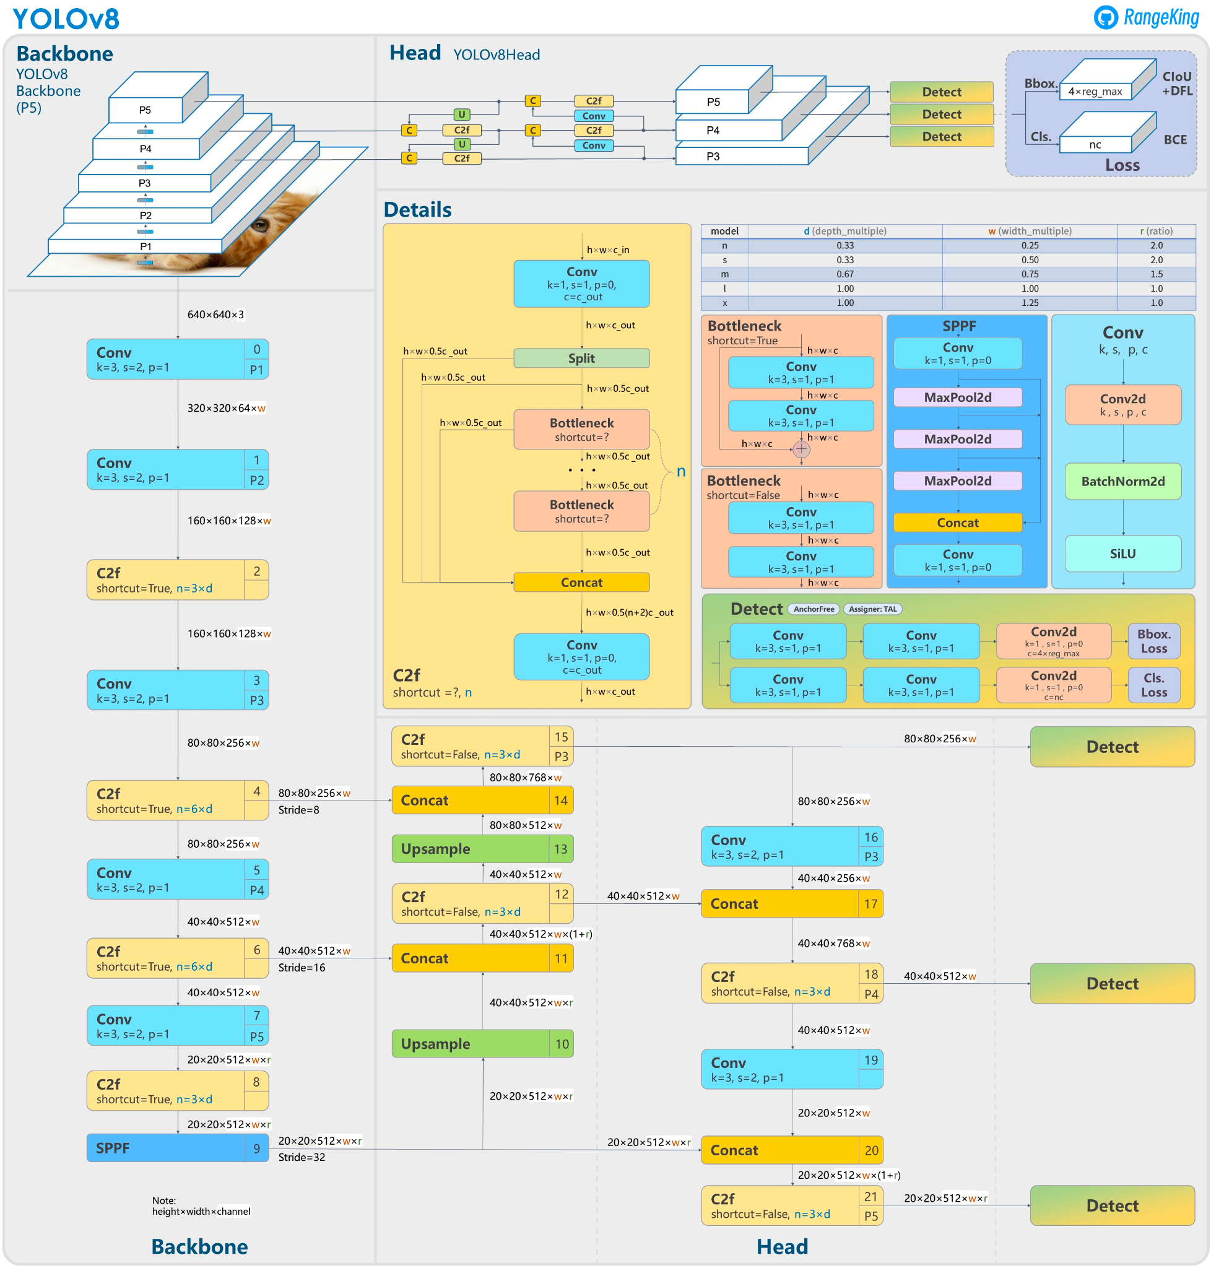
Objective 1: Model
Goal: Train a bounding-box object detection model to automatically bound and classify WBC, RBC, and platelets
To accomplish this goal, we trained our model using the YOLO v8 framework
YOLO v8 is the most recent edition of Ultralytic’s Pretrained “You Only Look Once” model^{[4]}
Notes:
53 convolutional layers followed by a series of fully connected layers.
Source: https://www.labellerr.com/blog/understanding-yolov8-architecture-applications-features/
Reasons we chose YOLO:
It is straightforward to take a custom labeled dataset and train a model based on the YOLO algorithm.
Once trained, the model can provide almost instantaneous predictions for new images. Real time processing capabilities is a huge benefit in the field of medical imaging.
YOLOv8 can handle multiple classes simultaneously, which allows the model to pick out white blood cells even when surrounded by red blood cells and platelets.
Activation Function: LEAKY ReLu

Slide 10
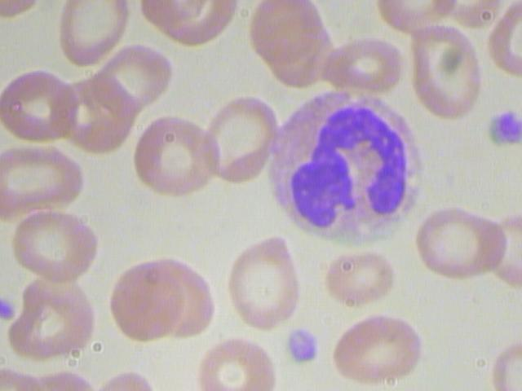
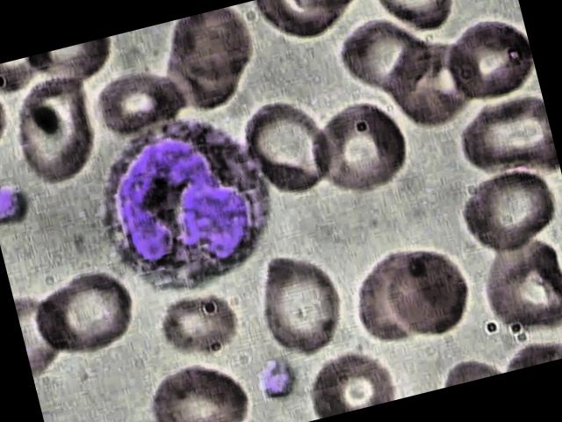
Preprocessing
Two key components of preprocessing:
1. Auto Adjust Contrast using Adaptive Equalization
2. Augmentation (Rotating and flipping images in training set)

Slide 11
Training
Hyper Parameter | Value
Learning Rate | 0.001
Confidence Threshold | 0.25
Non Maximum Suppression Threshold | 0.45
Intersection Over Union Threshold | 0.5
Number of Convolutional Layers | 53
Epochs | 25
Object Detection models are computationally expensive to train, making it difficult to perform a Grid Search for hyperparameter tuning
The best performing model we trained used these hyperparameters
Model finished training in about 10 hours

Slide 12
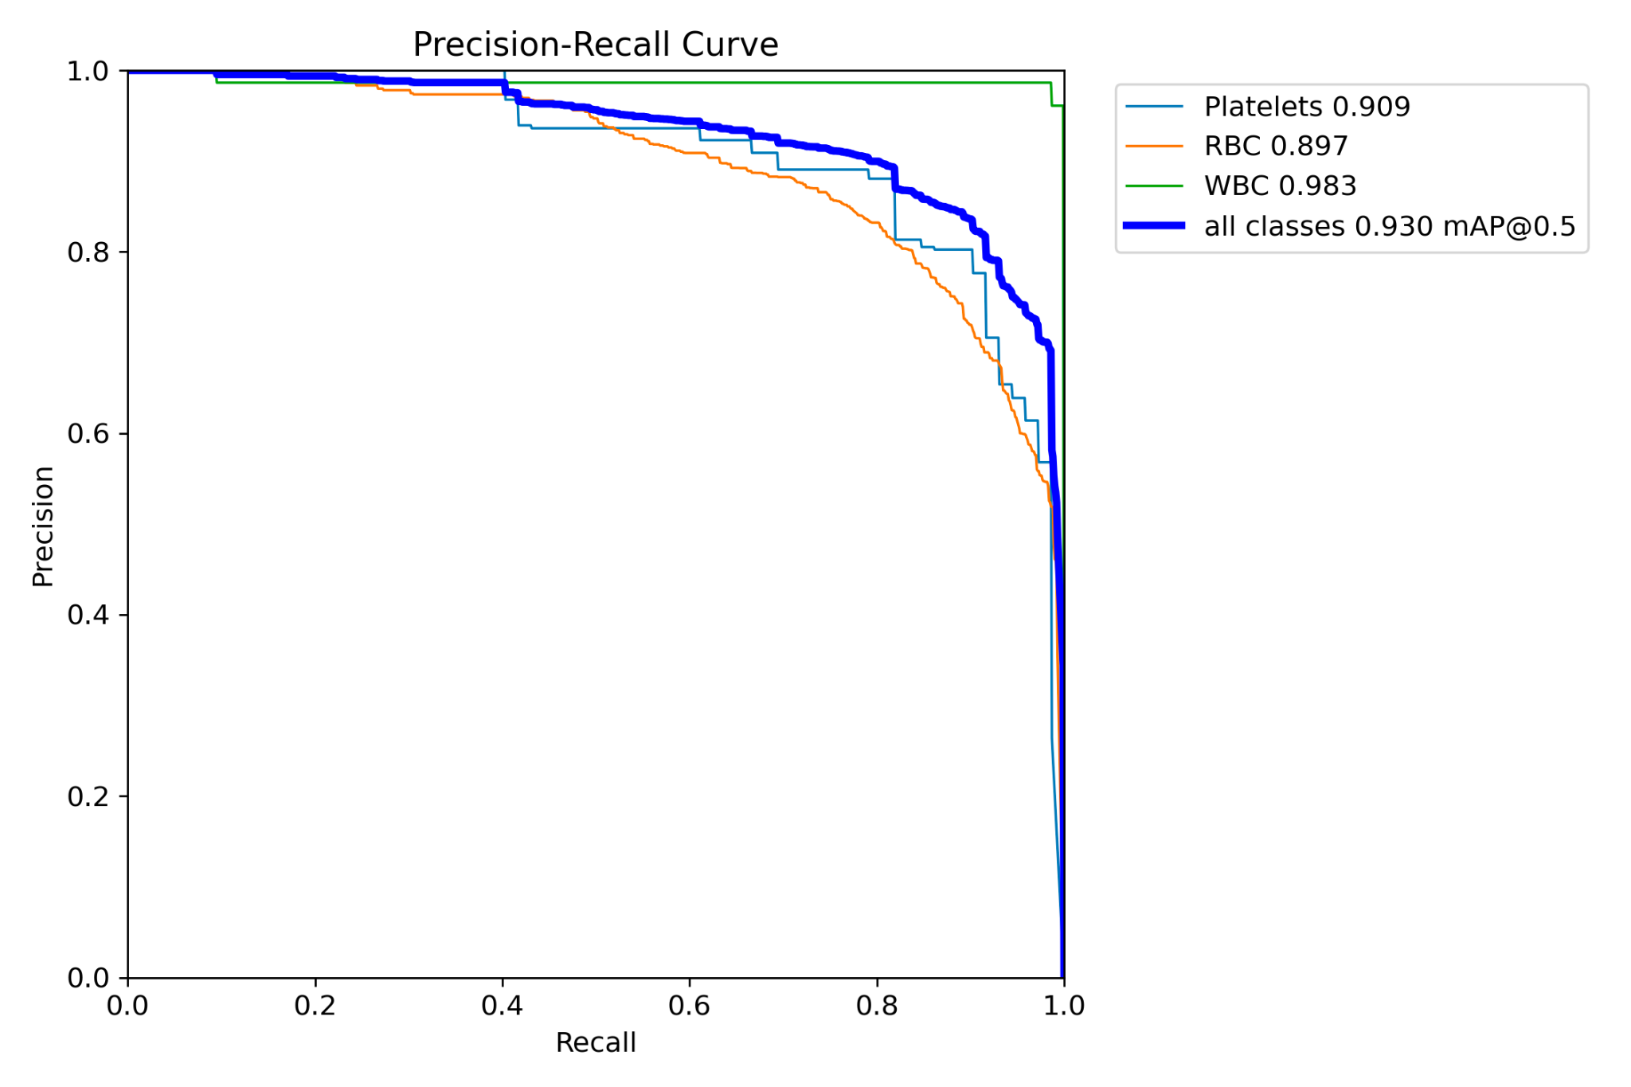
Results
Mean Average Precision (mAP): 0.93 across all classes
Focus class (WBC) performed especially well
0.983 mAP
Very high in both recall and precision metrics
Notes:
mAP @ 0.5 denotes a IoU threshold of 0.5

Slide 13
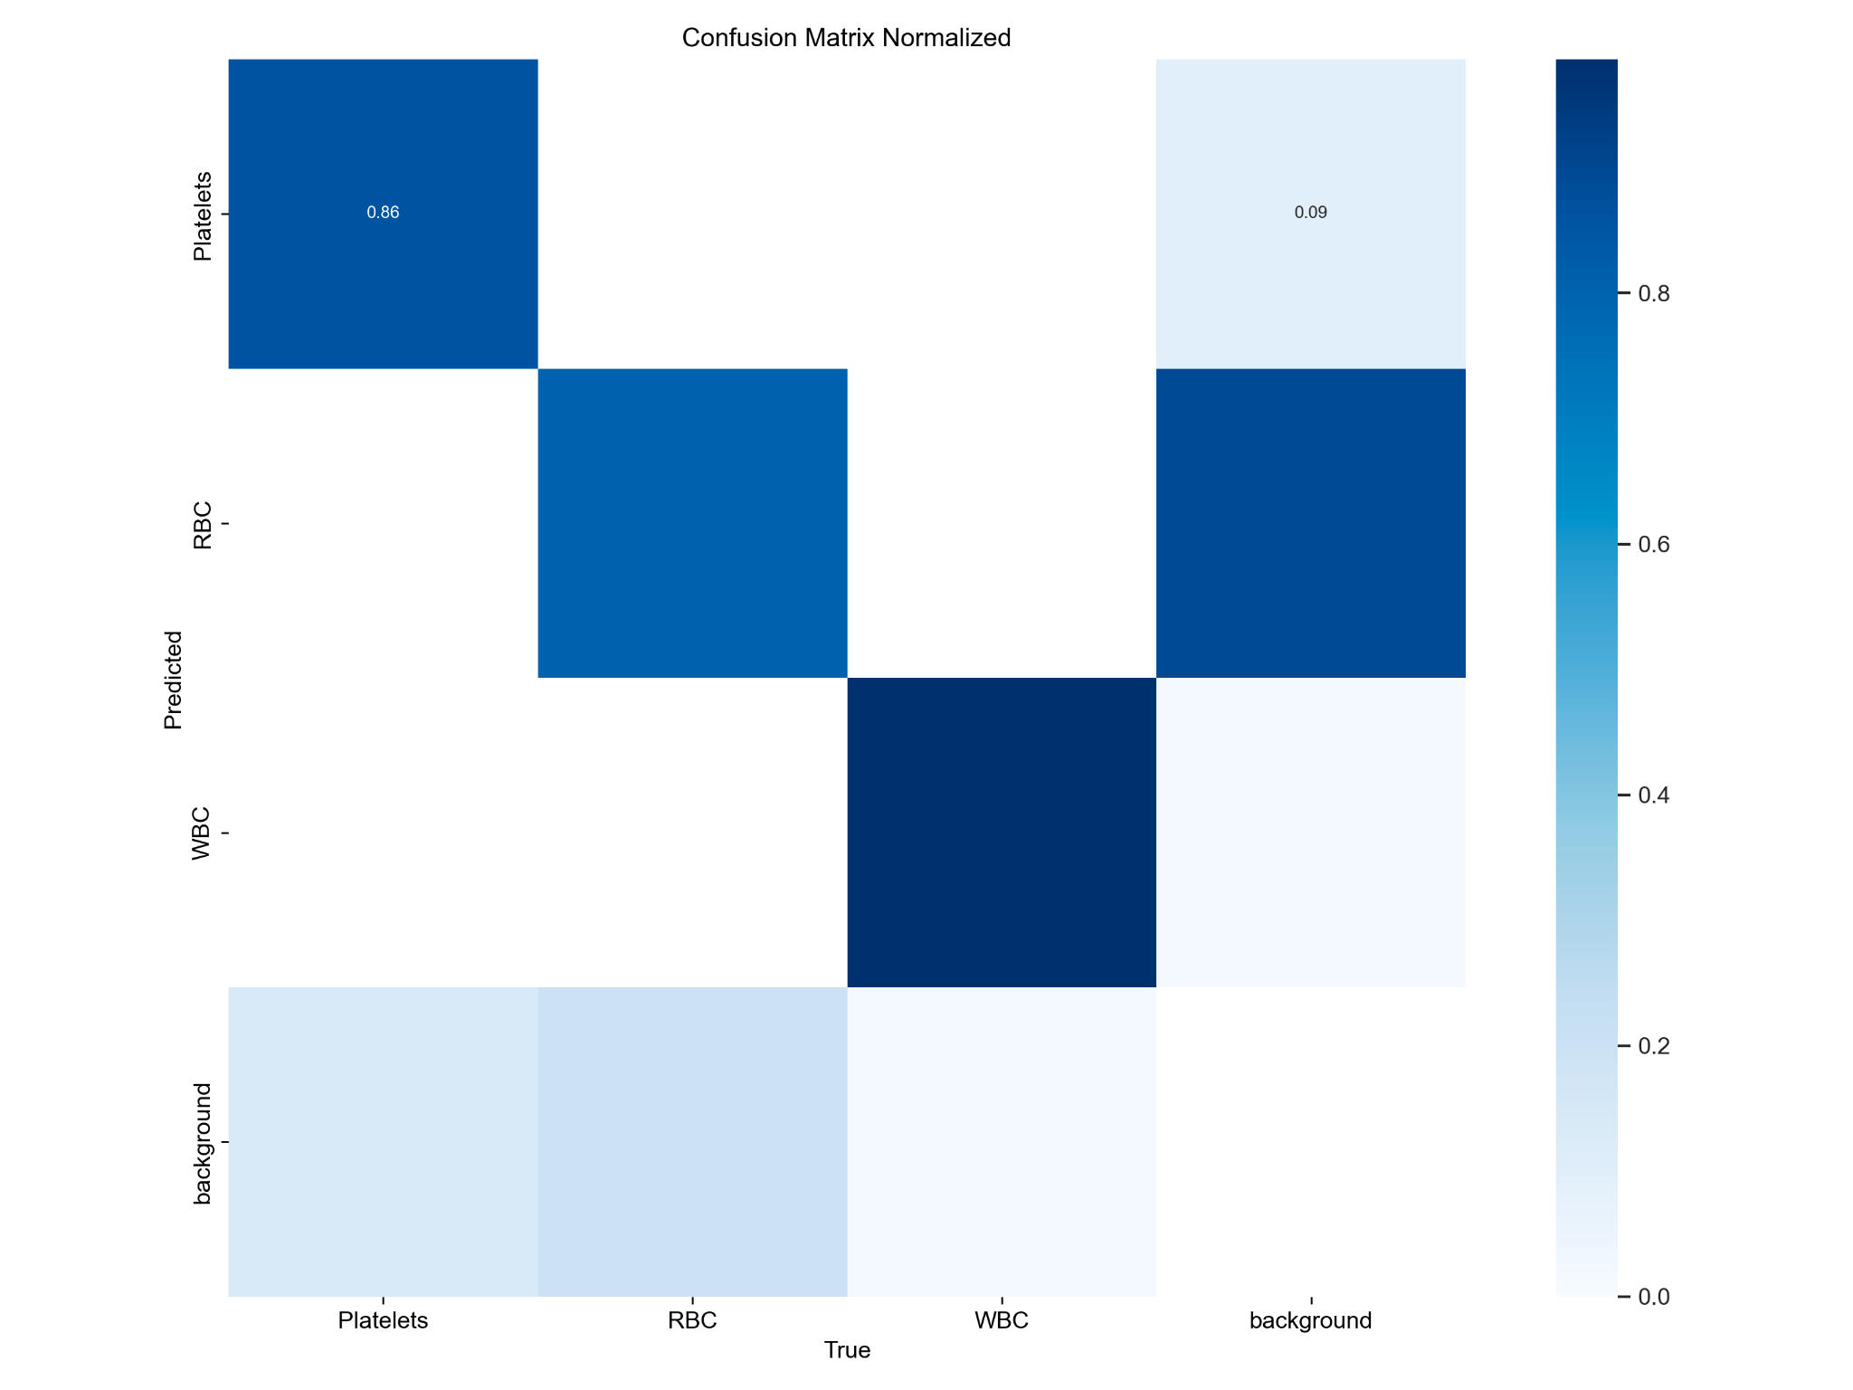
Most common mistake: failure to detect RBC.
Very few false positives for any class

Slide 14
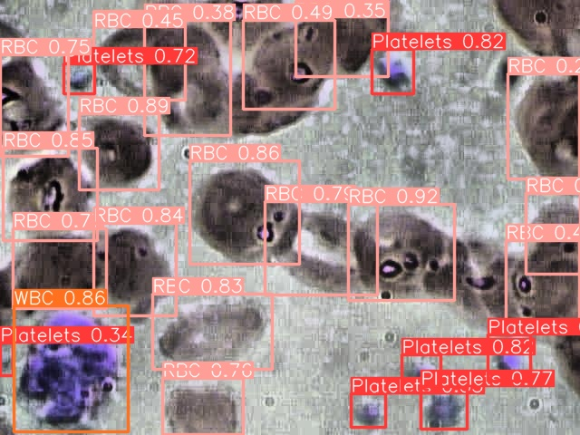
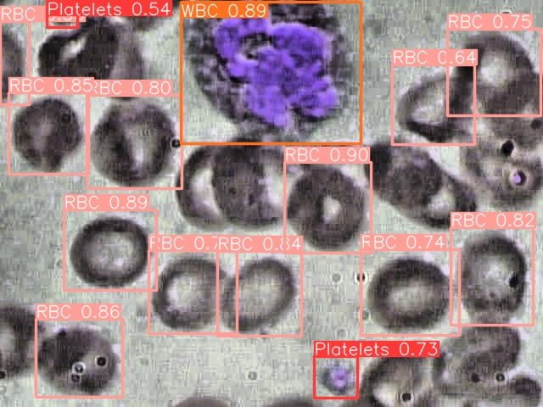
Results - Test Set Visualization
Notes:
Biggest misses occurred when RBC blend together -- adjusting the Non Maximum Suppression, IOU, and Confidence Thresholds would perhaps increase performance

Slide 15
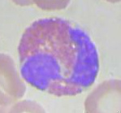
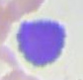
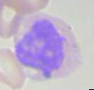
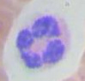
Objective 2: WBC Subtype Classification
We wanted to go one layer deeper and train a model to classify WBC subtypes, as this is an important aspect of blood differential testing
For this task we used a modified version of the original dataset which labels each WBC as one of four subtypes
EOSINOPHIL
LYMPHOCYTE
MONOCYTE
NEUTROPHIL
Notes:
Note: These cropped images were automatically generated by the first bounding box model
The second dataset is called dataset2

Slide 16
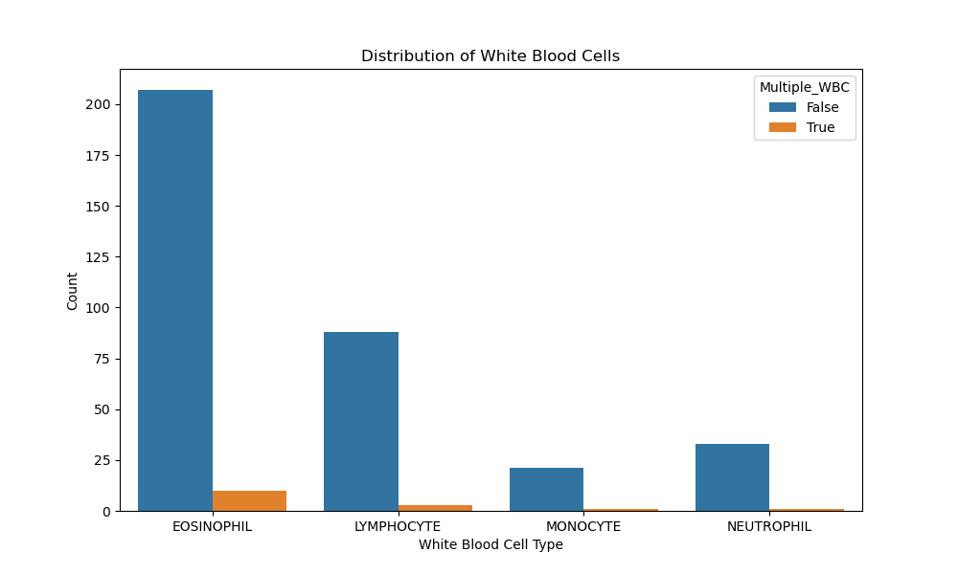
Objective 2: Data
The majority of images in dataset 2 contain only one white blood cell
The dataset is unbalanced towards Eosinophil White Blood Cell Types

Slide 17
Model Selection
Model | Test Set Accuracy
ResNet-50 | 87.62 %
VGG | 41.77 %
K-Nearest Neighbors | 38.0%
MobileNet | 32.36 %
XGBoost | 31.0 %
SVM | 31.0 %
Random Forest | 22.1 %
Due to the visual similarity of WBC subtypes, accurate classification proved difficult
We tested many models to compare performance
ResNet-50 performed the best on the test set
Notes:
Preprocessing similar to first model -- augmentation through flipping and rotating images.
MobileNet - MobileNet is a lightweight deep learning model designed for mobile and edge devices. It features depth-wise separable convolutions, where standard convolutions are split into depth-wise and point-wise convolutions. This architecture reduces computational complexity while maintaining accuracy, making it suitable for resource-constrained environments.
ResNet - Residual Networks (ResNet) are known for introducing residual learning, addressing the vanishing gradient problem in deep neural networks. It utilizes residual blocks, allowing the model to skip connections and learn residual functions. This architecture facilitates the training of very deep networks, promoting better feature extraction and representation.
VGG - The Visual Geometry Group (VGG) architecture is characterized by its simplicity and uniform structure. It consists of repeated blocks of convolutional layers with small 3x3 filters, ReLU activations, and max pooling. This straightforward design facilitates understanding and implementation, making it a popular choice for image classification tasks.
XGBoost: XGBoost is an ensemble learning algorithm that excels in structured data tasks. It builds a series of decision trees sequentially, correcting errors of the combined ensemble through gradient boosting. Known for its efficiency and scalability, XGBoost is widely used in regression, classification, and ranking problems.
Random Forest: Random Forest is an ensemble learning method that constructs multiple decision trees during training and outputs the aggregated result. It mitigates overfitting by training each tree on a random subset of features and data. This approach enhances robustness, making Random Forest a popular choice for various machine learning applications.
Support Vector Machine (SVM): SVM is a supervised learning algorithm used for classification and regression tasks. It seeks to find the optimal hyperplane that separates different classes in the feature space. SVM is effective in high-dimensional spaces and can handle linear and non-linear relationships using kernel functions, making it versatile in various domains.
K-Nearest Neighbors (KNN): KNN is a simple and versatile algorithm used for classification and regression. It predicts the class or value of a data point based on the majority class or average of its k nearest neighbors in the feature space. KNN is non-parametric and lazy, making it suitable for small to medium-sized datasets with no assumptions about data distribution.

Slide 18
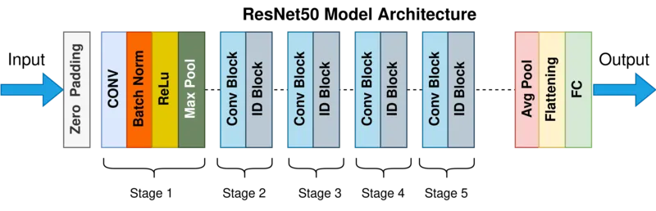
Model
ResNet-50 is a deep convolutional neural network (CNN) developed by Microsoft Research^{[5]}.
Three main stages:
1. Convolutional Layers: Extract features from the input images
ReLu activation function
Max Pooling and Batch Normalization
2. Convolutional / Identity Block Hidden Layers: Learns Residual Functions to map the input to its label
3. Fully Connected Layers: Generate the final classification
Notes:
Source: https://medium.com/@nitishkundu1993/exploring-resnet50-an-in-depth-look-at-the-model-architecture-and-code-implementation-d8d8fa67e46f#

Slide 19
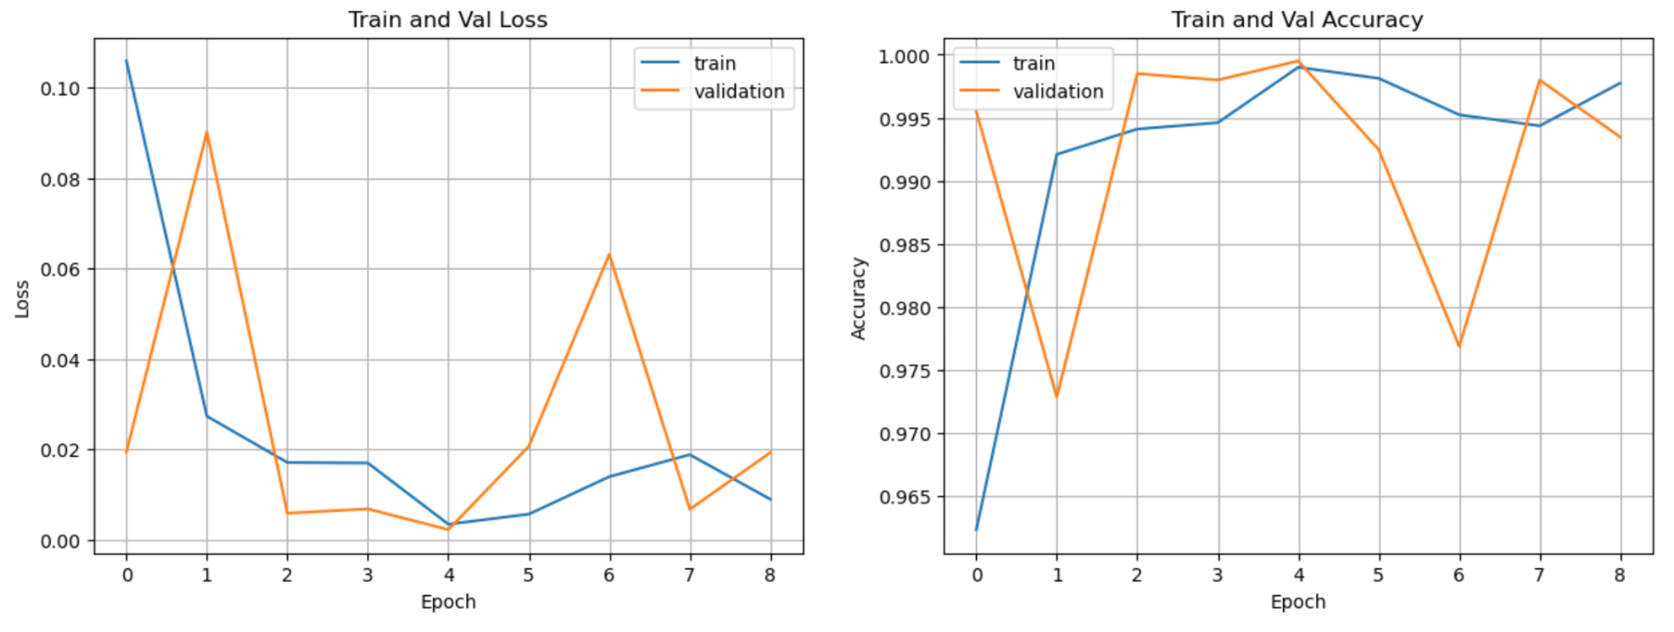
Training
Notes:
High Training and Validation accuracy.

Slide 20
Results -- Test Set
CLASS | PRECISION | RECALL | F1-SCORE
EOSINOPHIL | 0.85 | 0.84 | 0.84
LYMPHOCYTE | 1.00 | 1.00 | 1.00
MONOCYTE | 0.99 | 0.93 | 0.85
NEUTROPHIL | 0.74 | 0.93 | 0.82
EOSINOPHIL
LYMPHOCYTE
MONOCYTE
NEUTROPHIL
Notes:
Model did a great job with lymphocyte cells and monocyte cells, struggled with Neutrophil cells.

Slide 21
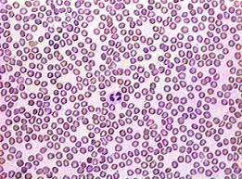
Limitations
Increasing the number of labeled images would likely improve performance
More time / computing power would allow for intensive hyperparameter tuning (i.e. through Grid Search Cross Validation)
Although machine learning has the potential to reduce costs for CBC tests, imaging technology would still be necessary in order to capture images of blood samples to feed into the cell segmentation and classification models.

Slide 22
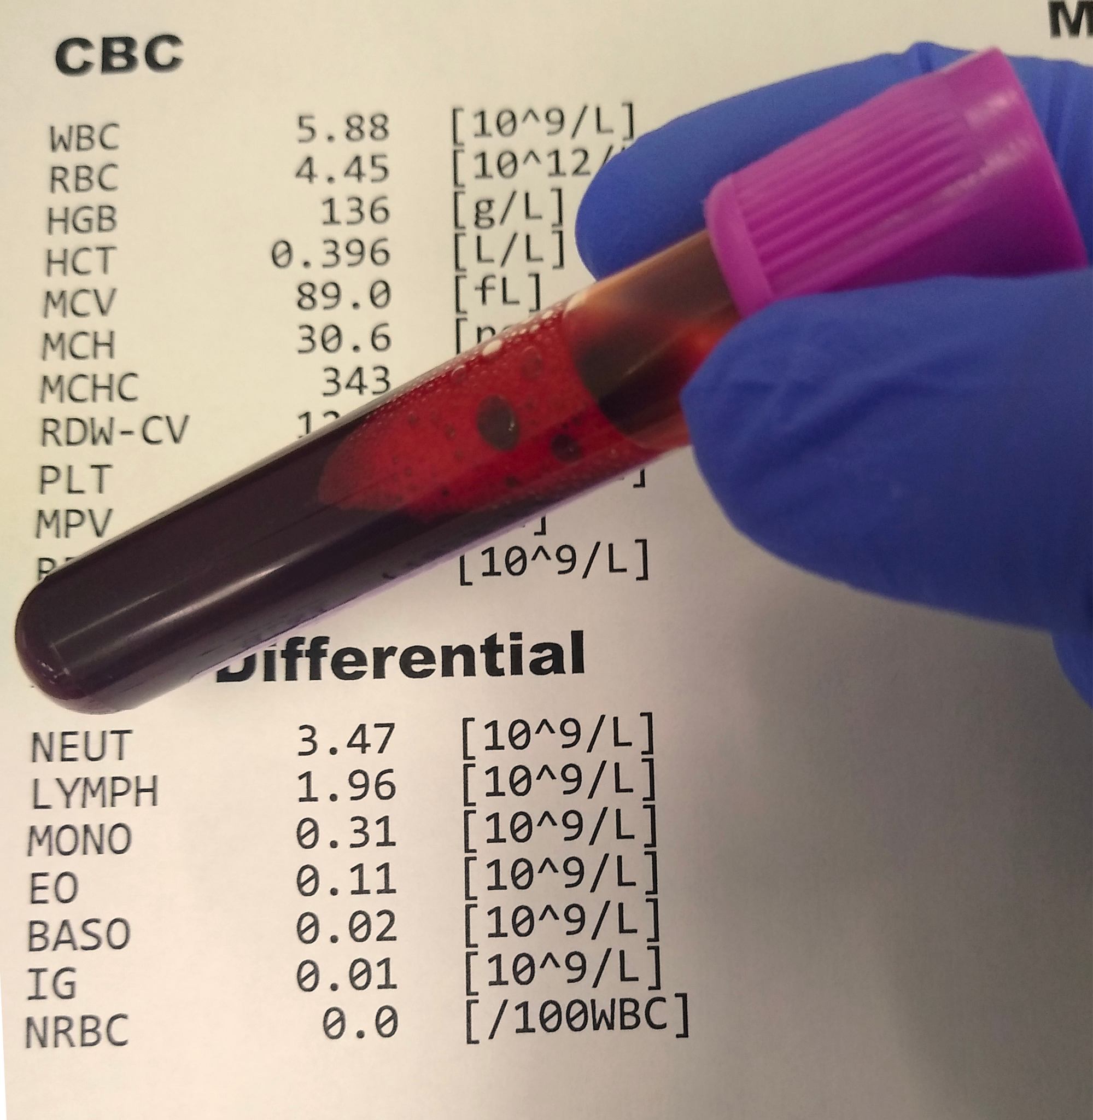
Conclusion
Machine Learning models offer an innovative and cost effective method for completing CBC and Blood Differential tests
Further exploration and experimentation in this field could lead to enhanced diagnostic accuracy, streamlined healthcare processes, and improved patient outcomes.

Slide 23
References
[1] Leukemia and Lymphoma Society (2023). Blood Cancer Statistics. Retrieved on October 6,
2023 from: https://www.lls.org/facts-and-statistics/facts-and-statistics-overview
[2] Dondelinger, Robert M. (2009). Hematology analyzers. Biomed Instrumentation & Technology. 2009 Jul; 43(4),
300-304. doi: 10.2345/0899-8205-43.4.300.
[3] Mooney, P. (2018). Blood Cell Images. Version 6. Retrieved on September 20, 2023 from
https://www.kaggle.com/datasets/paultimothymooney/blood-cells/data
[4] Jocher, G., Chaurasia, A., & Qiu, J. (2023). Ultralytics YOLOv8 (Version 8.0.0) [Software]. AGPL-3.0.
https://github.com/ultralytics/ultralytics
[5] He, K., Zhang, X., Ren, S., & Sun, J. (2015). Deep Residual Learning for Image Recognition. CoRR,
abs/1512.03385. Retrieved from http://arxiv.org/abs/1512.03385
**Note: Full Bibliography will be included in the Final Project Report

